Slide 1

Mergesort Complexity
ALGORITHMS & DATA STRUCTURES
DEPARTMENT OF COMPUTING
Exam revision - May 2019

Slide 2
Mergesort
Let’s assume 1 operation = 1 unit of time
function mergesort(s)
sl ← length(s)
if sl ≤ 1 then
return s
else
mid ← floor(sl/2)
left ← mergesort(s[0...mid-1))
right ← mergesort(s[mid...sl-1))
return merge(left,right)
end if
end function
N operations (units of time)
1 operation
1 operation
T(N)
T(N/2) (units of time)
T(N/2) (units of time)
N operations
T(N)= 2* T(N/2) + Θ(N)

Slide 3
Mergesort
T(N)= 2* T(N/2) + Θ(N)
The long way
(building the recursion tree)
The short way
(applying the Master Theorem)

Slide 4
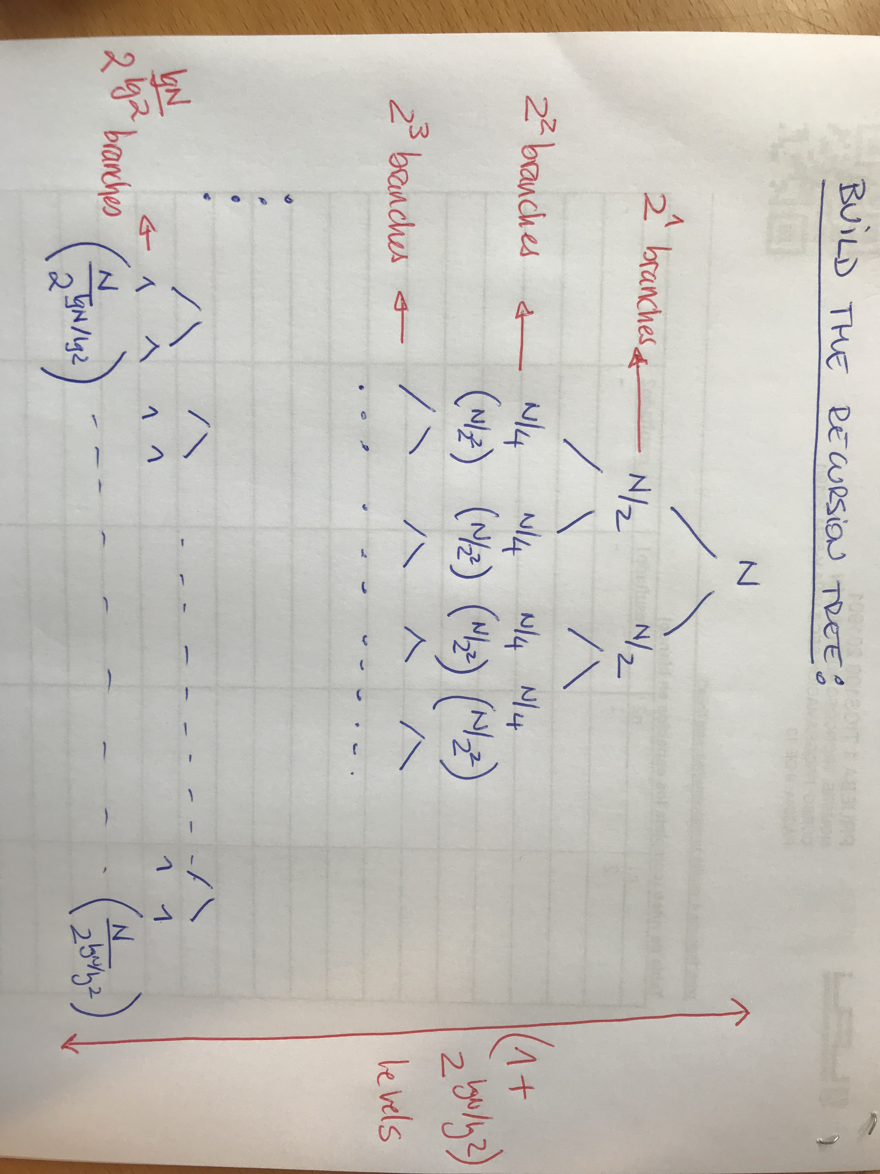
The long way: Recursion Tree
T(N)= 2* T(N/2) + Θ(N)

Slide 5
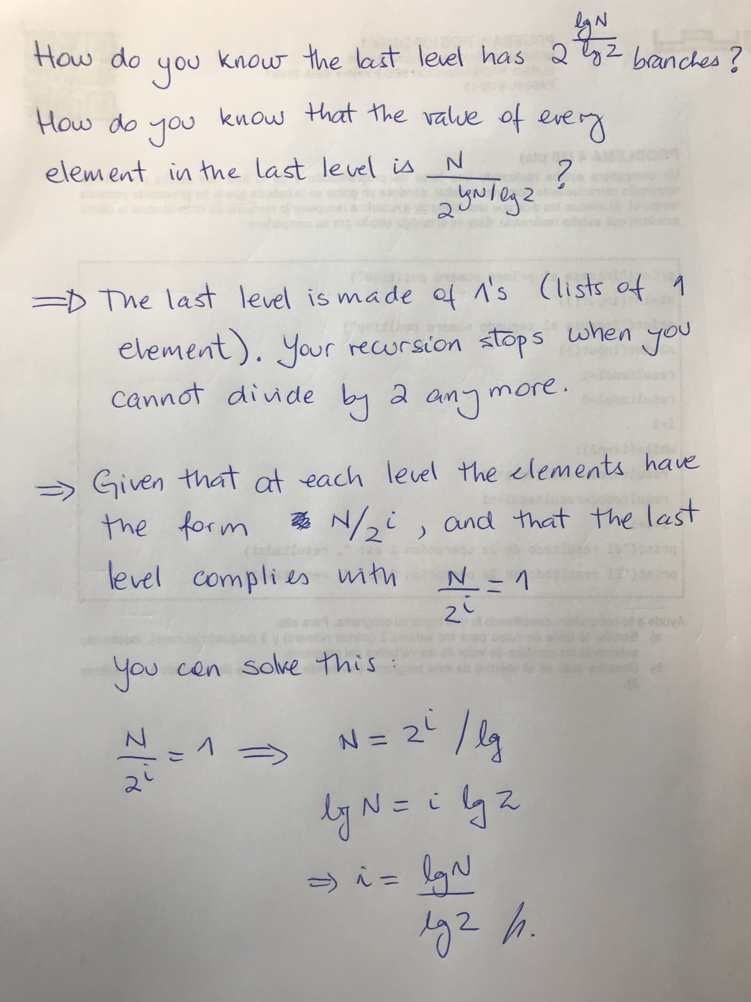
The long way: Recursion Tree
T(N)= 2* T(N/2) + Θ(N)

Slide 6
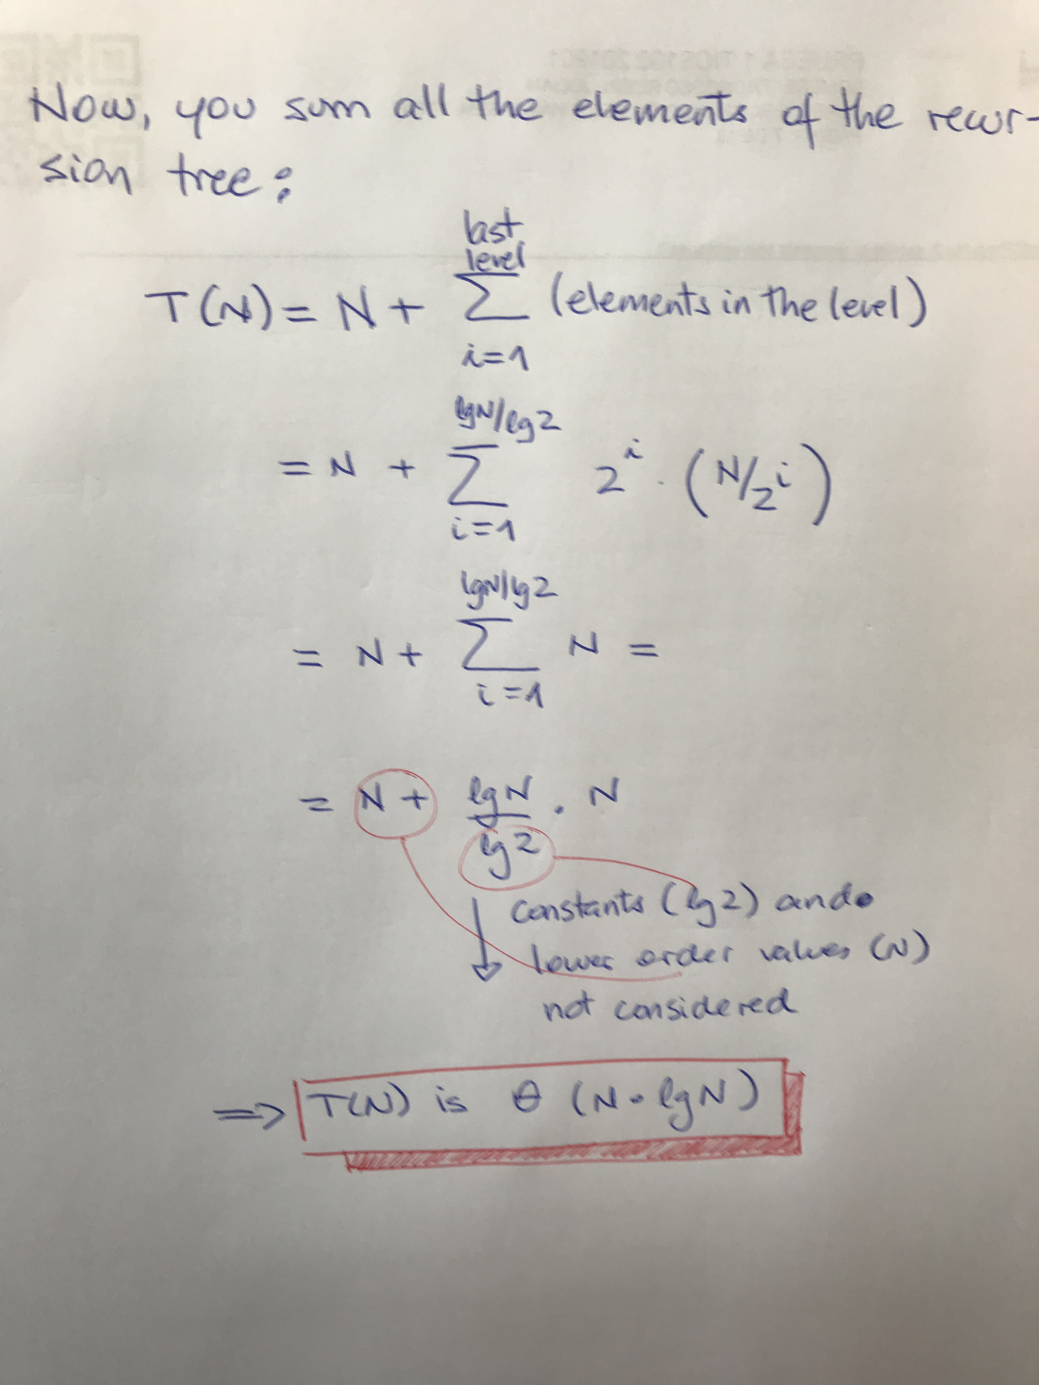
The long way: Recursion Tree
T(N)= 2* T(N/2) + Θ(N)

Slide 7
The short way: The Master Theorem
T(N)= 2* T(N/2) + Θ(N)
T(n) = aT(n/b)+ f(n)

Slide 8
The short way: The Master Theorem
T(N)= 2* T(N/2) + Θ(N)
log_{b}a
log_{b}a
Case 1
f(n)< n => T(n)=Θ(n )
log_{b}a
log_{b}a
Case 2
f(n)= n => T(n)=Θ(n lg n)
log_{b}a
Case 3
f(n)> n ( af(n/b)≤ c f(n)) => T(n)=Θ (f(n))
T(n) = aT(n/b)+ f(n)

Slide 9
The short way: The Master Theorem
T(N)= 2* T(N/2) + Θ(N)
log_{b}a
log_{b}a
Case 1
f(n)< n => T(n)=Θ(n )
log_{b}a
log_{b}a
Case 2
f(n)= n => T(n)=Θ(n lg n)
log_{b}a
Case 3
f(n)> n ( af(n/b)≤ c f(n)) => T(n)=Θ (f(n))
a=2
b=2
log_{b}a=1
< n¹ ?
f(n)=n=n¹
= n¹ ?
Yes, n¹ is exactly equal to n¹
> n¹ ?
T(n) = aT(n/b)+ f(n)

Slide 10
The short way: The Master Theorem
T(N)= 2* T(N/2) + Θ(N)
log_{b}a
log_{b}a
Case 1
f(n)< n => T(n)=Θ(n )
log_{b}a
log_{b}a
Case 2
f(n)= n => T(n)=Θ(n lg n)
log_{b}a
Case 3
f(n)> n ( af(n/b)≤ c f(n)) => T(n)=Θ (f(n))
a=2
b=2
log_{b}a=1
Case 2
log_{b}a
=> T(n)=Θ(n lg n)=Θ(n lg n)
T(n) = aT(n/b)+ f(n)

